Slide 1
Caring for Carers Resource:
Promoting the Health and Wellbeing of Wildlife Volunteers
Save Our Wildlife Foundation Inc (SOWFI)
Created by Joshua Kelleher and Ngan Van

Slide 2
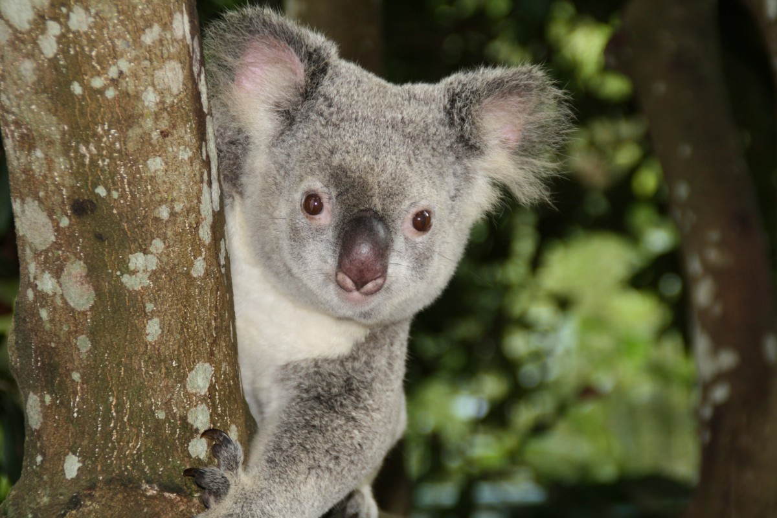
Table of Contents
Introduction
Risk factors for health and wellbeing
Defining compassion fatigue, burnout, trauma
Preventative strategies
Coping strategies
Compassion satisfaction/protective factors
Additional resources
References
Notes:
This Photo by Unknown Author is licensed under CC BY FlickR 2012 https://www.flickr.com/photos/158758966@N03/29947206757/

Slide 3
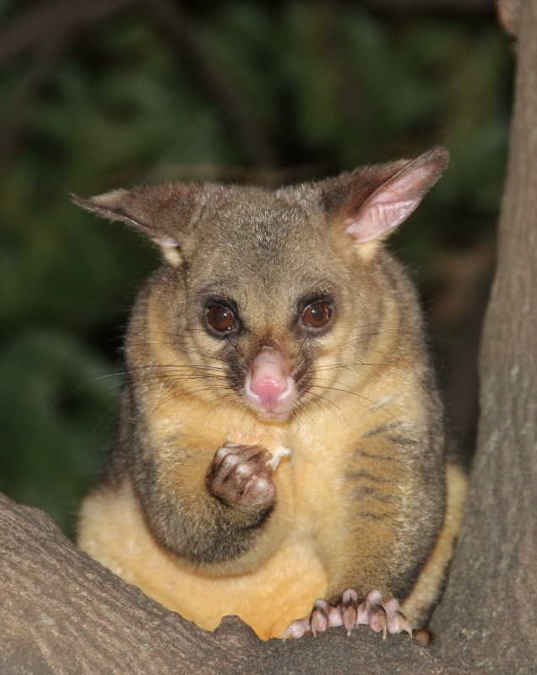
Introduction
Wildlife volunteers experience many positive emotions while working with animals, these include self-compassion, compassion satisfaction and happiness (Polachek & Wallace 2018).
Although there are many benefits to wildlife volunteering, strong commitment and emotional attachment can lead many wildlife volunteers to put their personal wellbeing at risk (Yeung, White & Chilvers 2017). In addition, the stress from caring and the exposure to distressing situations during rescues can lead to compassion fatigue, burnout and trauma, which if not properly managed can affect emotional and physical health (White et al. 2021).
Caregivers must be aware of the risk factors, signs, symptoms and management strategies of these health risks so they can address them early and reduce the impact it may have on their lives (Adimando 2018).

Slide 4
Risk Factors of Compassion Fatigue, Burnout and Trauma in Wildlife Volunteers
Experiencing a distressing situation when rescuing an animal
Taking an animal to get euthanized
Having an animal in care pass away
Looking after more animals/spending more time volunteering than you can handle
Not adapting volunteering schedule when other aspects of life get overwhelming
Not utilising social and emotional supports

Slide 5
What is Compassion Fatigue (CF)?
It is important to identify compassion fatigue early so that it can be addressed, signs and symptoms of CF include:
Absenteeism or presenteeism (engaging in activities when unwell or at an abnormally low level)
Decrease in effectiveness and quality of work
Mood swings
Excessive complaining
Emotional outbursts
Feelings of powerlessness
Distancing and isolating self from others
Anger
Sadness
Irritability
Guilt
Sleep disturbances
Concentration problems
Fatigue
Compassion fatigue is defined as “a state of exhaustion and dysfunction - biologically, psychologically, and socially - as a result of prolonged exposure to compassion stress and all that it evokes” (Figley 1995, p. 253).
Compassion fatigue is the result of being exposed to highly distressing situations such as high animal death rates and euthanasisia.
Compassion fatigue can lead to a declined level of care and compassion due to increased stress, feelings of confusion and helplessness (Caro 2019).
(Adimando 2018; Ericson‐Lidman & Strandberg 2007; Levitt & Gezinski 2020; Lloyd & Campion 2017 )
*Early signs and symptoms* (Ekstedt & Fagerberg 2005; Ericson‐Lidman & Strandberg 2007)

Slide 6
What is Burnout?
Burnout occurs when exposed to constant emotional pressure and excessive workload and is a gradual development initiated by long-term emotional exhaustion (Caro 2019).
Burnout is defined as feelings of exhaustion, cynicism and inefficacy (Maslach 2003).
A study that explored the feelings of people who experienced burnout stated that ‘the intense focus on their duties made them blind and deaf to influences or warning signs from their bodies, their colleagues or family [and] sometimes their ill-being was obvious, even to a complete stranger’ (Ekstedt & Fagerber 2005, p. 63).
It is important to recognise the early signs of burnout to assist in preventing it before it can further develop (Ekstedt & Fagerber 2005).
Signs and Symptoms:
Absenteeism
Decrease in effectiveness and quality of work
Emotional exhaustion
A reduced sense of personal accomplishment
Cynicism (a negative outlook and perspective)
Inefficacy (reduced capability)
Persistent fatigue
Feeling trapped
Reduced self-care
Social withdrawal
Increased passiveness (overly compliant, low initiative)
Headaches
Muscular pain
Fever
(Cheng 2005; Ekstedt & Fagerber 2005; Lloyd & Campion 2017)
*Early signs and symptoms* (Ekstedt & Fagerberg 2005; Ericson‐Lidman & Strandberg 2007)
Notes:
It is important to understand that burnout can occur, that is why it is important to listen to your body and the people around you.

Slide 7
What is Trauma?
Direct trauma (PTSD)
Post-traumatic stress disorder (PTSD) is defined by Seides (2010, p. 725) as ‘an anxiety disorder that develops from events that are interpreted as traumatic’. The term direct trauma is used when someone experiences or witnesses a distressing situation that negatively affects them (Moir & Van den Brunk 2020).
Signs and Symptoms:
Recurrent thoughts
Nightmares
Feelings (intrusion)
Voidance of emotions
Flashbacks
Nightmares
Avoidance symptoms such as dissociation
Negative cognitions
Hyperarousal symptoms such as anxiety and hypervigilance
(Bennett & Rohlf, 2005; Friedman et al. 2011; Moir & Van den Brunk 2020; Scotney 2017)

Slide 8
What is Trauma?
Secondary traumatic stress (STS)
The reaction that caregivers experience as a result of long term-exposure to and caring for victims of trauma, where the only difference to PTSD is direct exposure to the original trauma (Andrukonis, Hall & Protopopova 2020).
Signs and Symptoms:
Fear
Sleep difficulties
Intrusive images
Avoiding reminders of traumatic experience
Wildlife volunteers are susceptible to both direct trauma and secondary trauma from situations such as: seeing distressing animal deaths, having to care for animals in unfortunate situations and having animals pass away while in care.

Slide 9
Preventative Strategies

Slide 10
Individual Preventative Strategies
Self-care
Self-care strategies protect ourselves from the negative effects of empathic engagement that causes compassion fatigue (White et al. 2021).
Examples of self-care strategies
Relaxation - Taking a “time out’
Recreational activities
Journaling
Proactive activities
Lifestyle changes
Eating healthy
Exercising more - e.g. going for a hike
Learn relaxation techniques - e.g. meditation or yoga
Reduction of working hours
Ensuring adequate sleep
Relaxation techniques and other forms of self care have been shown to have a significant beneficial effect on PTSD and stress (Adimando 2018; Ofei-Dodoo et al. 2020).

Slide 11
Mindfulness
Example of a mindfulness activity: Observing leaf mindfulness
This exercise requires a leaf and your attention.
Pick up a leaf and hold it in your hand.
Give it your full attention for five minutes.
Notice the colors, the shape, the texture, and the patterns.
This will bring you into the present and align your thoughts with your current experience.
Self-compassion break: https://www.youtube.com/watch?v=HJVJsgCi1uo&ab_channel=Mindfulness
Mindfulness
‘Mindfulness is associated with positive psychological strengths such as emotional intelligence, the ability to cope with failure, as well as improving relationship functioning, help-seeking behaviour and self-care’ (Neff 2004; Neff and Germer 2013; Neff et al. 2018; Krageloh et al. 2019 cited in Moir & Van den Brunk 2020, p. 7).
Mindfulness self-compassion
Learning to be more compassionate towards ourselves allows us to utilise coping strategies that help us adapt when confronted with a stressful situation (Lloyd & Campion 2017).
Lloyd & Campion (2017, p. 5) state that ‘The aim is to be able to identify the source of the stressor and have the ability to accept the emotions that are connected to it, whether they are positive or negative’.
Notes:
https://srwc-mb.ca/mindful/
https://positivepsychology.com/mindfulness-exercises-techniques-activities/

Slide 12
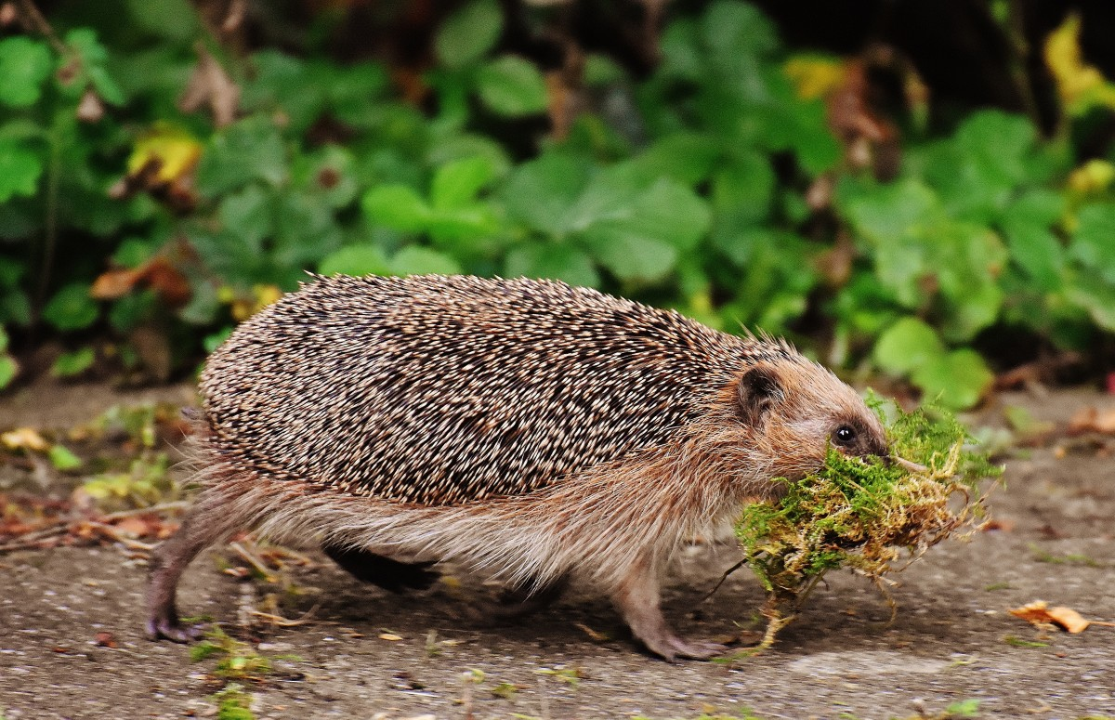
Resilience
Skills & strategies to promote characteristics of resilience:
Improving connections between colleagues
Mutual support in a group environment
Adopting healthy self-care strategies
Being aware of personal and environmental triggers that could exacerbate compassion fatigue and burnout
Encourage discussion around positive aspects of wellbeing as part of the culture within the organisation
Engaging in educational resilience-building activities
Perform acts of kindness
Engage in reflection
Practice gratitude
Participate in mindfulness
Resilience building
Wildlife volunteering can be a potentially stressful role, therefore an individual who is resilient will be able to adaptively cope in stressful situations (Lloyd & Campion 2017). Building resilience counteract the effects of “over engagement” in distressing or difficult situations (White et al. 2021).
Personal qualities or traits of resilience:
Optimism
Self-confidence
Level headedness
Hardiness
Having the ability to be resourceful during times of adversity
(Lloyd & Campion 2017; Moir & Van den Brink 2020; White et al. 2021; Yeung, White & Chilvers 2017)

Slide 13
Team Preventative Strategies
Team Environment
Improving connections and facilitating strong relationships between team members acts as a good support mechanism. This can be achieved through:
Promoting good communication skills among team members and team leaders
Encourage conversations at team meetings
Increase involvement in decision making (Cheng 2005)
Connecting with each other
Participate in team-building activities
Provide opportunities for team members to meet face-to-face
Debrief
Provide opportunities to debrief with team leaders and peers individually or as a group
Participate in debriefing session after an emotionally stressful encounter such as euthanasia (Lloyd & Campion 2017)
Engage in low-impact debriefing by utilising self-awareness, fair warning, consent, and limited disclosure to give the listener time to prepare (Mathieu 2012)
(Levitt & Gezinski 2020; Lloyd & Campion 2017; Moir & Van den Brink 2020; White et al. 2021)

Slide 14
Organisational Preventative Strategies
Create a culture where discussions about positive aspects of wellbeing are encouraged and discussed.
Engage in positives activities such as community outreach and public education.
Celebrate successes as a group during team meetings, on social media or through the newsletter.
Provide opportunities for ongoing learning, education, knowledge, resource, training, workshops such as:
Peer debriefing strategies and support programs
Wellbeing training on topics including:
Stress management
Resilience-building
Compassion fatigue
Mindfulness
Life balance
(Cheng 2005; Levitt & Gezinski 2020; Lloyd & Campion 2017; Moir & Van den Brink 2020; White et al. 2021)

Slide 15
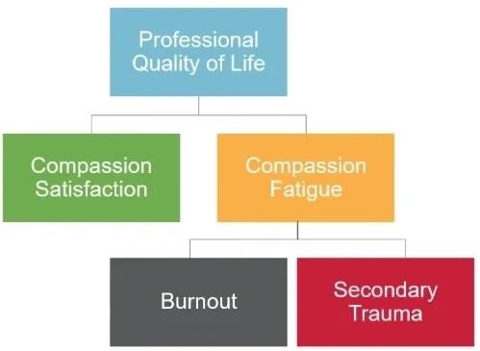
Professional Quality of Life Measure
Identify individuals at risk using the Professional Quality of Life Measure (ProQOL). https://proqol.org/
“The ProQOL is the most commonly used measure of the negative and positive effects of helping others who experience suffering and trauma. The ProQOL has sub-scales for compassion satisfaction, burnout and compassion fatigue.” (The Center for Victims of Torture 2019).
Access the concise manual for the ProQOL scale by Stamm (2010) to learn how to effectively use the ProQOL: https://proqol.org/proqol-manual
The scale can be used to self-monitor satisfaction and a prompt for self-care.
(The Center for Victims of Torture 2019)

Slide 16
Coping Strategies
Problem focused coping
Identify the most stressful aspects of the volunteer role
Break it down into smaller tasks
Identify the most stressful aspects of the volunteer role or what can be changed to make things easier
Alter the situation itself, or establish an action plan to change them to make them more manageable. For example, reducing the amount of animals in care or caring for older animals that require less time.
(Pavani et al. 2016)
Self-care and mindfulness - can be used as a preventative strategy and a coping strategy
Positive reappraisal - look for the positive meanings behind a negative event (Pavani et al. 2016). For example, think about the quality of life of an injured animal if released back into the wild... euthanasia offers a way to end a wildlife animal’s pain and suffering.
Actively avoid ruminations - Which is the repetitive generation of thoughts about negative events and feelings(Pavani et al. 2016). Engage in activities that you enjoy as this is an effective way to create more neutral or positive thoughts (Lyubomirsky et al. 1999).
Seeking emotional support - seek help, advice, comfort, and support from family, friends, professionals and other volunteers (Allen & Leary 2010).

Slide 17
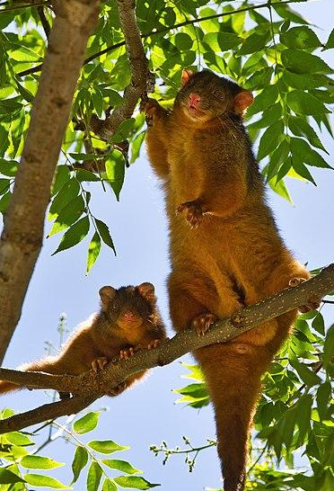
Compassion Satisfaction
Compassion satisfaction is one's ability to find happiness in their work (Lloyd & Campion 2017).
The gratification one gets from their work from:
Helping animals in need of care
Being productive and aware of their meaningful contribution to the community
Having a sense of personal fulfilment and purpose in all that the job entails
Achieving personal and work-related goals
Interacting with the companion animals in their care
(Levitt & Gezinski 2020; Moir & Van den Brunk 2020)
Providing care for animals may be a protective factor against developing compassion fatigue, burnout, and secondary traumatic stress (Andrukonis, Hall & Protopopova 2020).
Mercer 2014, Family of Common Ringtail Possums

Slide 18
Additional Resources

Slide 19
Resources for Self-care
Self-care: https://twogreenthreads.org/a-self-care-resource-for-wildlife-volunteers/
Podcasts for Wildlife Volunteers: https://twogreenthreads.org/wildlife-heroes-caring-for-carers-podcast/
Building resilience: https://twogreenthreads.org/take-care-to-give-care/
Learn how to meditate (2 min video): https://youtu.be/rqoxYKtEWEc
Understanding and coming to terms with psychological trauma: https://www.phoenixaustralia.org/recovery/recovery-online/
Tips for Falling Asleep: https://youtu.be/FulTaDhEtDY
Mental health help & support: https://twogreenthreads.org/mental-health-help-and-support/
Bushfire recovery: https://twogreenthreads.org/bushfire-recovery-resources-to-help-our-community/

Slide 20
Mental Health Helplines
Lifeline | 13 11 14
Wildtalk | 1300 307 111 | https://wildtalk.org.au/
Counselling service to provide mental health assistance for wildlife volunteers
Beyond Blue | 1300 224 636
MensLine Australia | 1300 789 978
Suicide Call Back Service | 1300 659 467
Kids Helpline | 1800 551 800
Headspace | 1800 650 890
QLife | 1800 184 527
Relationships Australia | 1300 364 277
ReachOut Australia | https://au.reachout.com/

Slide 21
References
Adimando, A 2018, ‘Preventing and alleviating compassion fatigue through self-care: An educational workshop for nurses’, Journal of Holistic Nursing, vol. 36, no. 4, pp. 304-317.
Allen, A.B. & Leary, M.R 2010, ‘Self‐Compassion, stress, and coping’, Social and personality psychology compass, vol.4, no.2, pp.107-118.
Andrukonis, A Hall, NJ & Protopopova, A 2020, ‘The Impact of Caring and Killing on Physiological and Psychometric Measures of Stress in Animal Shelter Employees: A Pilot Study’, International journal of environmental research and public health, vol. 17, no. 24, pp. 9196.
Bennett, P & Rohlf, V 2005, ‘Perpetration-induced traumatic stress in persons who euthanize nonhuman animals in surgeries, animal shelters, and laboratories’, Society & Animals, vol. 13, no. 3, pp. 201-220.
Brady, JL Guy, JD Poelstra, PL & Brokaw, BF 1999, ‘Vicarious traumatization, spirituality, and the treatment of sexual abuse survivors: A national survey of women psychotherapists’, Professional psychology: Research and practice, vol. 30, no. 4, pp. 386.
Caro, JR 2019, ‘Compassion Fatigue among Wildlife Rescue and Rehabilitation Workers in South Africa’, The Chicago School of Professional Psychology..
Cheng, Y 2005, ‘Caregiver burnout: A critical review of the literature’, Alliant International University, San Diego.
Ekstedt, M & Fagerberg, I 2005, ‘Lived experiences of the time preceding burnout’, Journal of advanced nursing, vol. 49, no. 1, pp. 59-67.
Ericson‐Lidman, E & Strandberg, G 2007, ‘Burnout: co‐workers’ perceptions of signs preceding workmates’ burnout’, Journal of Advanced Nursing, vol. 60, no. 2, pp. 199-208.

Slide 22
References
Figley, CR 1995, ‘Compassion fatigue: Toward a new understanding of the costs of caring’.
Friedman, MJ Resick, PA Bryant, RA Strain, J Horowitz, M & Spiegel, D 2011, ‘Classification of trauma and stressor‐related disorders in DSM‐5’, Depression and anxiety, vol. 28, no. 9, pp. 737-749.
Levitt, AL & Gezinski, LB 2020, ‘Compassion Fatigue and Resiliency Factors in Animal Shelter Workers’, Society & Animals, vol. 28, no. 5-6, pp. 633–650.
Lloyd, C & Campion, DP 2017, ‘Occupational stress and the importance of self-care and resilience: focus on veterinary nursing’, Ir Vet J, vol. 70, no. 30, https://doi.org/10.1186/s13620-017-0108-7.
Lyubomirsky, S Tucker, KL Caldwell, ND & Berk, K 1999, ‘Why Ruminators Are Poor Problem Solvers: Clues From the Phenomenology of Dysphoric Rumination’, Journal of Personality & Social Psychology, vol.77, no.8, 1041-1060.
Maslach, C 2003, ‘Job burnout: New directions in research and intervention’, Current Directions in Psychological Science, vol. 12, pp. 189–192.
Mathieu, F 2012, ‘The compassion fatigue workbook: Creative tools for transforming compassion fatigue and vicarious traumatization’, Routledge.
Mercer, A 2014, Family of Common Ringtail Possums, Creative Commons, <https://commons.wikimedia.org/wiki/File:Common_Ringtail_Possum_-_AndrewMercer_IMG13854.jpg>.
Moir, FM & Van den Brink, ARK 2020, ‘Current insights in veterinarians’ psychological wellbeing’, New Zealand Veterinary Journal, vol. 68, no. 1, pp. 3-12.
Moreno-Jiménez, MP & Villodres, MCH 2010, ‘Prediction of Burnout in Volunteers’, Journal of Applied Social Psychology, vol. 40, no. 7, pp. 1798–1818.

Slide 23
References
Ofei-Dodoo, S Cleland-Leighton, A Nilsen, K Cloward, JL & Casey E 2020, ‘Impact of a mindfulness-based, workplace group yoga intervention on burnout, self-care, and compassion in health care professionals: a pilot study’, Journal of occupational and environmental medicine, vol. 62, no. 8, pp. 581-587.
Pavani, J.B, Le Vigouroux, S, Kop, J.L, Congard, A & Dauvier, B 2016, ‘Affect and affect regulation strategies reciprocally influence each other in daily life: The case of positive reappraisal, problem-focused coping, appreciation and rumination’, Journal of Happiness Studies, vol. 17, no. 5, pp. 2077-2095.
Polachek, AJ & Wallace, JE 2018, ‘The paradox of compassionate work: a mixed-methods study of satisfying and fatiguing experiences of animal health care providers’, Anxiety, Stress, & Coping, vol. 3, no. 2, pp. 228-243.
Potter, P Dicanbeigi, J Berger, J Norris L, & Olsen S 2010, ‘Compassion fatigue and burnout: Prevalence among oncology nurses’, Clinical Journal of Oncology Nursing, vol. 14, no. 5, pp. E56.
Seides, R 2010, ‘Should the current DSM-IV-TR definition for PTSD be expanded to include serial and multiple microtraumas as aetiologies?’, Journal of Psychiatric and Mental Health Nursing, vol. 17, no. 8, pp. 725–731.
Scotney, R 2017, ‘Occupational Stress & Compassion Fatigue: The effects on workers in animal-related occupations’.
Stamm, B 2010, ‘The concise manual for the professional quality of life scale’.
The Center for Victims of Torture 2019, Professional Quality of Life Measure, Professional Quality of Life Measure, viewed 1 June 2021, <https://proqol.org/ProQol_Test.html>.
White, B Yeung, P, Chilvers BL & O’Donoghue K 2021, ‘Reducing the “cost of caring” in animal-care professionals: Social work contribution in a pilot education program to address burnout and compassion fatigue’, Journal of Human Behavior in the Social Environment, pp. 1-20, DOI: 10.1080/10911359.2020.1822249.
Yeung, P White, B & Chilvers, BL 2017, ‘Exploring Wellness of Wildlife Carers in New Zealand: A Descriptive Study’, Anthrozoös, vol. 30, no. 4, pp. 549–563.

